Slide 1

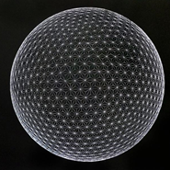

Space - A Final Frontier
Mentors
Sunny Kumar
Mubashir Uddin
Varun Kumar
By - Anup Singh

Slide 2
MOGA Modelling

Slide 3

MODEL
Multi-objective genetic algorithm (MOGA) modelling is used.
Two objectives -
1) maximize J1 (payload mass) => metric tons
2) minimize J2 (cost) => $
The basic model structure is the single stage liquid rocket.The rocket has a cylindrical body and is capped with a cone.
The rocket dimensions are determined by the -
Radius( ) and,
Length of Propellant tanks ( L )
The thrust parameters T1, T2, T3, T4, and T5 define the thrust at 0 km, 50 km, 100 km, 200 km, and 400 km altitudes, respectively.

Slide 4
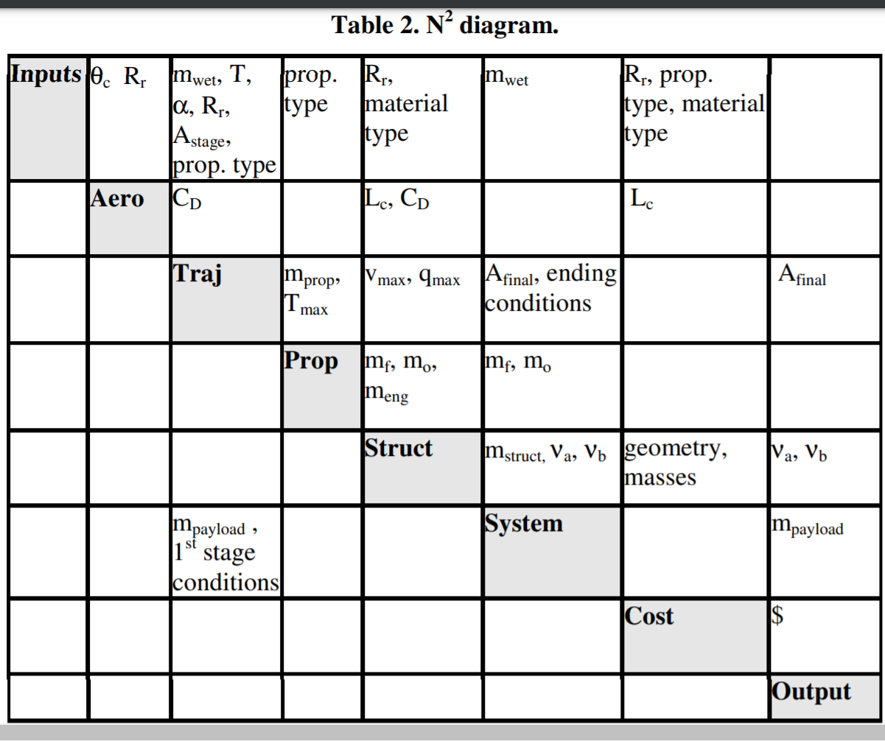

Slide 5

The thrust angle parameter variables α1 and α2 define the angle of the thrust vector over the course of the trajectory.
α1 is the altitude in km to start turning the rocket
α2 specifies the additional altitude over which to complete the turn.
If Altitude < α1 , angle=0 ,
Altitude > (α1 +α2) , angle = π/2 and,
(α1 +α2) < Altitude < α1 , angle = [ 1-cos (π*(A-α1)/α2 ) ] * π/4
Aerodynamics
The aerodynamics subsystem calculates the cone length
⇒ Coefficient of drag

Slide 6

(2) Trajectory Subsystem
takes in several inputs and calculates the fuel usage and final altitude via
Shooting Method.
Uses the ODE with state vector composed of
-radial position,
-radial velocity,
-longitude,
-angular velocity , and
- mass

Slide 7



(3) Propulsion Subsytem
Inputs the mass of propellant from the trajectory subsystem,divides this mass up
into oxidizer and fuel, and adds an ullage penalty.
Where, = Space Shuttle engine mass
(4) Structure Subsystem
Inputs the propellant masses and some drag quantities. It then sizes the propellant tanks to hold the propellant, and the rocket length to hold the tanks.
The tanks are sized to hold propellant at the necessary pressure, while the rocket
structures are sized to withstand the thrust and drag loads from the point of ma maximum dynamic pressure, .

Slide 8
(5) Cost Subsystem
calculates the cost for both materials and manufacturing. The material costs are
based on material masses and engine mass.
The engine has the highest cost per kilogram.
The cost parameters include :
- cost per meter of seam and
- cost per kg of material.
Finally, the costs are summed and the payload mass is calculated according to -

Slide 9
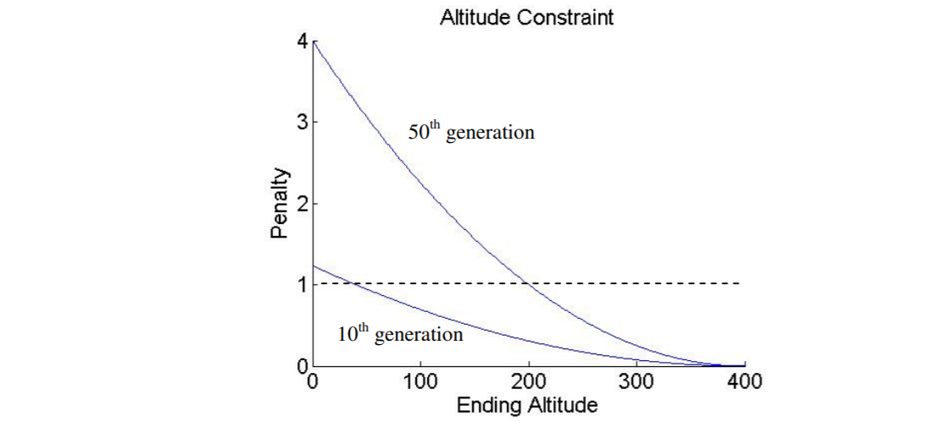
Optimization Method
The two objectives were to maximize J1 (payload mass) and minimize J2 (cost).
The fitness function for a feasible point -

Slide 10
Sensitivity Analysis
Normalized Sensitivity = ∆%performance / ∆%variation
Some of the sensitivities are either both positive or both negative for payload mass and cost.
This means that increasing the payload mass also increases the cost, so it does not make a strictly better design.

Slide 11
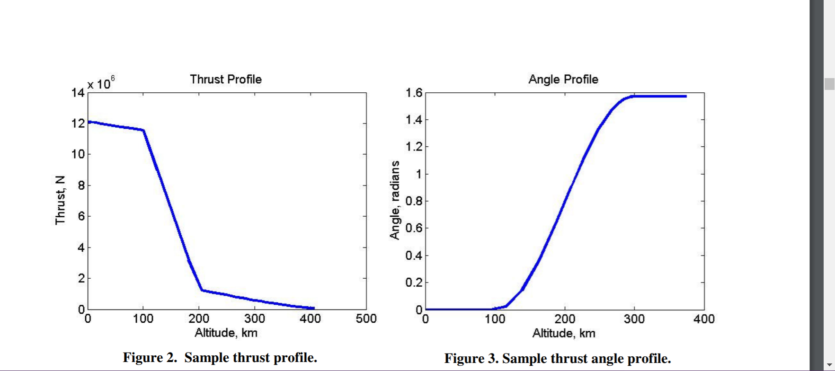
Matlab
We will use some matlab coding for solving ODE and Spline Linear Interpolation.

Slide 12
Reference Link
http://strategic.mit.edu/spacelogistics/pdf/AIAA-2006-1720-231.pdf
https://studylib.net/doc/10834598/integration--of-system-level--optimization-with--concurrent

Slide 13
Thank You

